Slide 1
ENCS691K Project Presentation
Instructor: Dr. Roch H. Glitho
Student: Ali Sangari

Slide 2
Project Overview
Auction Service which allows,
User registration
User login
User account termination
Adding new products
Placing products in auction
Biding on products that are placed in auction by other users

Slide 3
Provisioned cloud services/providers
Amazon AWS EC2
FreeTier service for one year, free
http://52.33.242.200:8080/AuctionService/
* Preferred service, due to offered flexibility and freedom to use any application of choice.
Microsoft Azure
DreamSpark (student account), free
http://asangari.azurewebsites.net/AuctionService/

Slide 4
Challenges in setting up AWS EC2
Setting up security
Figuring out how to configure the security to be able to access my application remotely (through a browser) took the most time. I realized may people had a similar issue the first time they tried to use EC2.
Remote connection to the VM
Installation of required applications
Firewall configuration

Slide 5
Challenges in setting up MS Azure
The free service has many limitations compared to Amazon Web Services.
These limitations include application containers/servers, databases (SQL and NoSQL).
Understandability, Azure imposes fewer limitations on Microsoft Ecosystem users.

Slide 6
Auction Service
To develop this web app, I used RESTful web services in java.
Using RESTful services, front-end and back-end of the application become completely decoupled and also allows for better scalability of the application.

Slide 7
Objects relationships
Product
User
Belongs to
Contains
AuctionTimer
Auction
Times products
In auction

Slide 8
Deployable project file
The following .war file can be used to deploy the application in tomcat. (requires java 1.7)

Slide 9
Deployable project file
The following .zip file can be extracted and imported into eclipse. (requires java 1.7, and Maven plug-in for eclipse)

Slide 10
Screenshots
The following slides show parts of the application.
To see the description of each screenshot, make sure to have PowerPoint’s notes section visible.

Slide 11
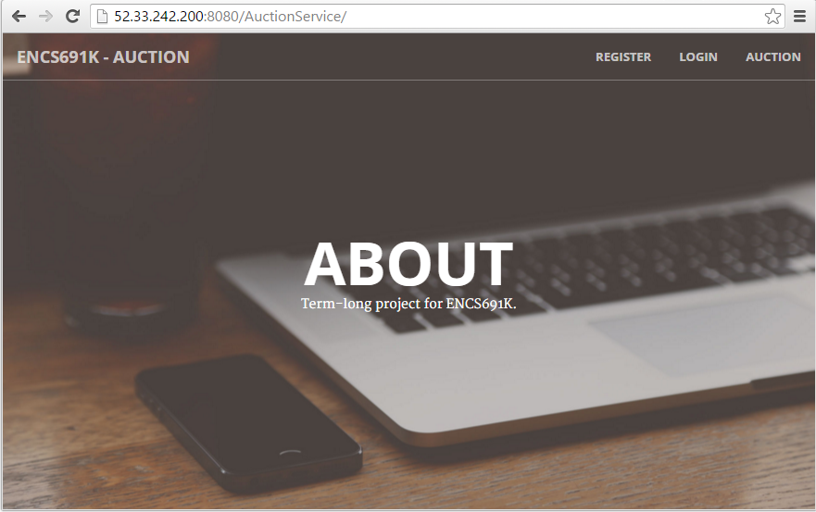
Application – Initial state
Notes:
In the initial state, application allows users to Register, Login and view items that are in auction. Other parts of the application requires users to be logged in to the system.

Slide 12
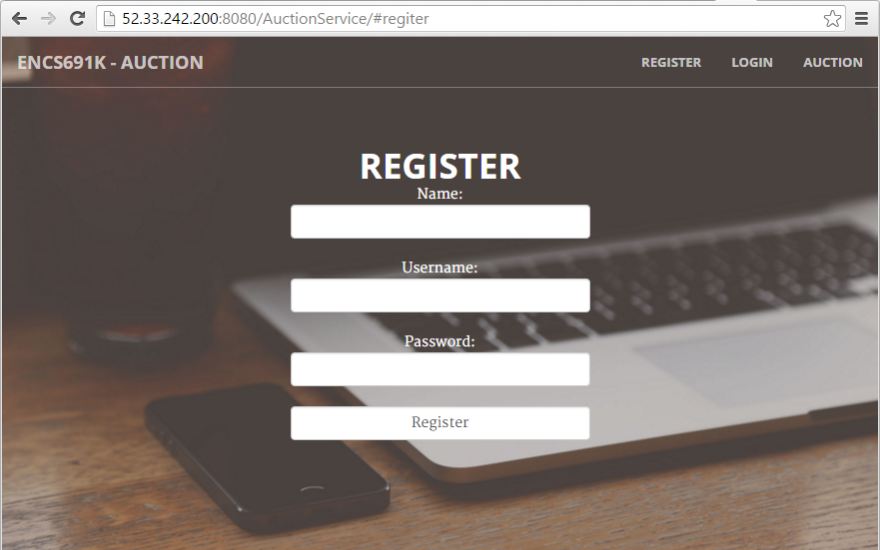
User Registration
Notes:
After user registers, he/she is automatically logged in to the system and redirected to My Items page. Some pages are only visible one the user has logged in.

Slide 13
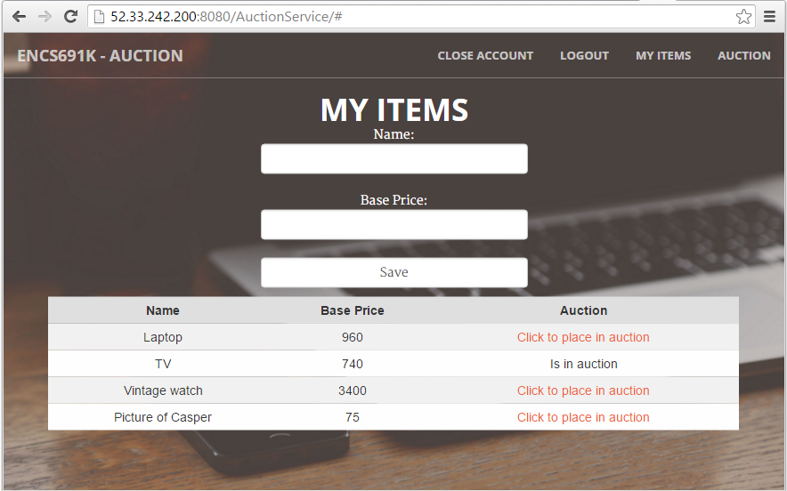
Product records
Notes:
In My Items page, user can create new products. Also he/she can place any of their existing items in auction. As soon as an item enters the auction, a timer is started for one minute. After the one minute, if there are any bids on the product, that item is removed from auction and its ownership is transferred to the user with the highest bid. Otherwise, it stays in auction for another minute before the same check-and-action is repeated.

Slide 14
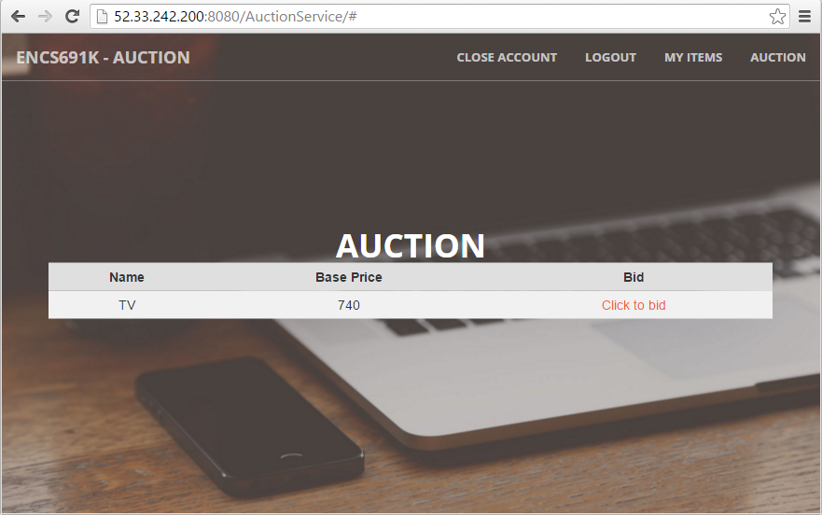
Products available for auction
Notes:
When a user clicks on “Click to bid”, the current bid is increased by five units (dollars). Timer and bid increment can be modified in Constants.java.

Slide 15

Instructor: Dr. Roch H. Glitho
Student: Ali Sangari

